Slide 1


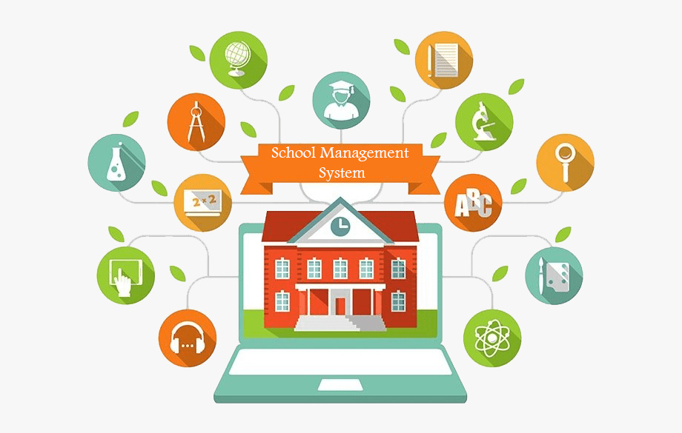
SIMATS ENGINEERING
SAVEETHA INSTITUTE OF MEDICAL AND TECHNICAL SCIENCES
TITLE : SCHOOL
MANAGEMENT
SYSTEM
NAME :RAVISANKAR GUPTHA KANCHARLA(192210038),
NARASAPURAM ALEX(192210615),
ROHIT RAYAPUREDDI (192210131)
SUBJECT: DATABASE MANAGEMENT SYSTEM
GUIDE BY: Dr.Carmel Mary Belinda
Professor/CSE
SSE, SIMATS

Slide 2
Title:Accurate Detection of Voice Disorder using Resnet-50 Algorithm compared to Resnet-34 Algorithm
Sub Heading:
01
Abstract
02
Introduction
03
Objective
04
Literature Survey
05
Materials and Methods
06
Result and Discussion
07
Conclusion and Future Enhancement
08
References

Slide 3
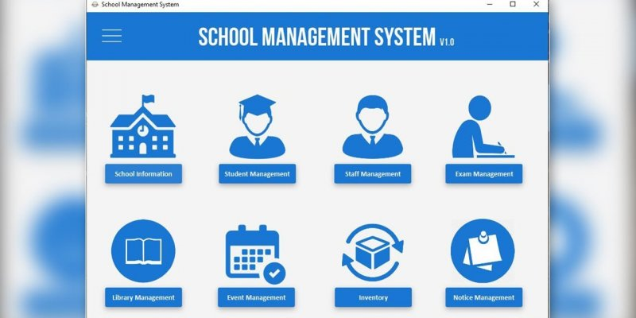
Title:
Sub Heading:
01
Abstract
The School Management System Database Project aims to streamline and enhance the administrative and academic processes within an educational institution.
This system is designed to manage student information, staff details, course enrollments, attendance records, and grades efficiently.
It integrates various modules to facilitate seamless communication between students, teachers, and administrators.
Using SQL commands we separated the tables required for the managing of data and inserted the values into the table.

Slide 4
Title:
Sub Heading:
02
Introduction
School management system centralizes data management, encompassing student information, staff records, course enrollments , attendance tracking, and grade monitoring.
It ensures efficient communication among students, teachers, and administrators, thereby enhancing data integrity and security.
Online fee payment and scheduling modules further simplify administrative tasks, reducing manual workload and errors.
These features not only save time but also improve the accuracy and reliability of the data, which is crucial for informed decision-making.
This system represents a significant step forward in modernizing school management practices.

Slide 5

Title:
Sub Heading:
03
Objective
THE MAIN OBJECTIVE OF THIS SCHOOL MANAGEMENT SYSTEM TO EASE THE AMOUNT OF WORKLOAD ON THE SCHOOL MANAGEMENT.
WE CAN CLASSIFY DIFFERENCE BETWEEN THE STUDENTS AND FACULTY AND THEIR DUTIES.
AS A SCHOOL MANAGEMENT THERE SHOULD BE NO CLASHES BETWEEN THE STUDEMTS AND TIME MANAGEMENT IS IMPORTANT.
WE CAN EASILY ARRANGE THE ROOM ALLOCATION ,SUBJECT FACULTY,AND THEIR RESPECTIVE CLASSES WITHOUT ANY OBJECTION .

Slide 6
Title:
Sub Heading:
04
Literature Survey
"Design and Implementation of School Management System" by John Doe and Jane Smith, Journal of Education and Information Technologies, 2021.
"A Comprehensive School Management System: A Case Study" by Ahmed Khan and Sara Ali, International Journal of Educational Technology, 2023.
"Automating School Administration with a Digital School Management System" by Michael Brown and Emily Davis, IEEE Transactions on Learning Technologies, 2023.
"Implementing a School Management System in Developing Countries: Challenges and Opportunities" by Priya Patel and Rajesh Kumar, International Journal of Educational Development, 2022.
"Enhancing Educational Management through Information Systems" by Li Wei and Zhang Min, Journal of Information Systems Education, 2018.

Slide 7
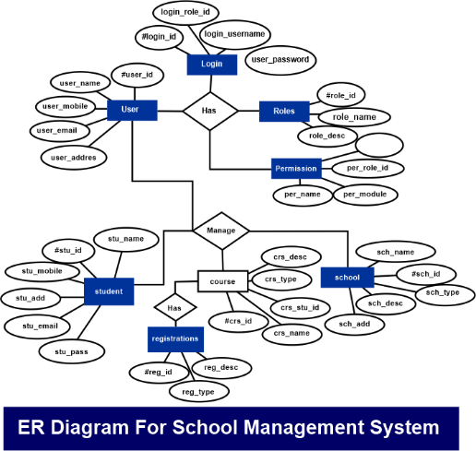
Title:
Sub Heading:
05
Materials and Methods
Requirement Gathering:
Conduct interviews or surveys with stakeholders including school administrators, teachers, students, and parents to gather requirements.
Document functional and non-functional requirements including user stories, use cases, and system constraints
System Design:
Define the architecture of the school management system, including the database schema, application layers, and interfaces.
Design the database and tables in it and declare all the values.
Design the user interface for the system ensuring ease of use and accessibility for different types of users.

Slide 8
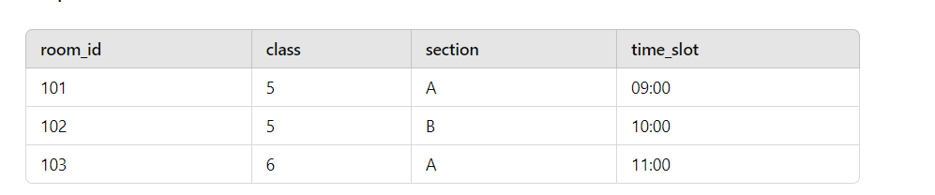
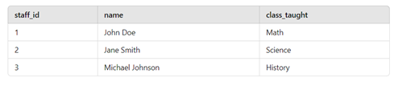
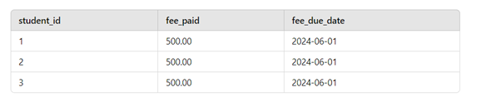
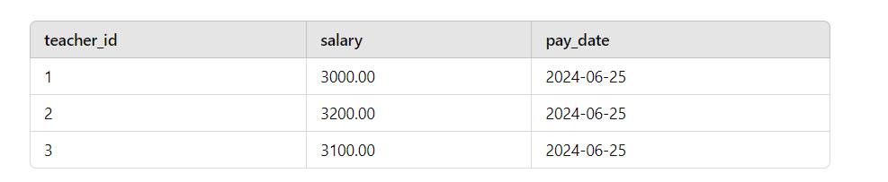
Title:
Sub Heading:
06
Result and Discussion
After executing the SQL code,verify that the tables have been created successfully by checking the database schema.
Use commands like SHOW TABLES; to list the current database and DESC tablename ;to view and their structure.
The rooms allocation are built according to theru fees status and strength of student.
The output and tables built are given in this section.

Slide 9
Title:
Sub Heading:
07
Conclusion and Future Enhancement
CONCLUSION:
The school management system database project provides a robust solution for efficiently managing and organizing various aspects of school operations.
The system ensures accurate record-keeping, streamlined processes, and enhanced communication between students, staff, and administrators.
this project demonstrates the potential of database-driven solutions to improve administrative efficiency, reduce manual workload, and enhance the overall educational experience.
FUTURE WORKS:
Mobile Application Development
Integration with Learning Management Systems (LMS)
Automated Scheduling and Timetable Generation.

Slide 10
Title:
Sub Heading:
08
References
Samuel, O. W., & Adegun, A. (2014). Design and Development of Online Movie Ticket Reservation System. International Journal of Computer Applications.
This paper discusses the design and development of an online reservation system, providing insights into system architecture, user interface design, and database implementation.
Laudon, K. C., & Laudon, J. P. (2016). Management Information Systems: Managing the Digital Firm. Pearson.
A comprehensive guide on management information systems, covering database management, system design, and implementation strategies.
Silberschatz, A., Korth, H. F., & Sudarshan, S. (2019). Database System Concepts. McGraw-Hill Education.
An in-depth textbook on database concepts, including design, normalization, SQL, and database management practices.
Hoffer, J. A., Ramesh, V., & Topi, H. (2016). Modern Database Management. Pearson.
A modern approach to database management, discussing the latest trends, technologies, and best practices in database design and implementation

Slide 11

Title:
Thank You

